Slide 1


Social Buzz

Slide 2


Today's agenda
Project recap
Problem
The Analytics team
Process
Insights
Summary

Slide 3

Social Buzz is a rapidly growing technology unicorn that needs to swiftly adapt to its expanding global presence. Accenture has initiated a three-month proof of concept (POC) concentrating on the following key tasks:
Conducting an audit of Social Buzz's big data practices.
Providing recommendations for a successful IPO.
Analysing and identifying the top five most popular content categories
on the Social Buzz platform.
Project Recap

Slide 4

Over 100,000 posts per day
36,500,00 pieces of content Annually
How can Social Buzz effectively leverage its vast content data to maximize engagement?
Conducting an analysis to identify the top five most popular content categories on the Social Buzz platform.
Problem

Slide 5



Yashwant Singh
Data Analyst
The Analytics team
Marcus Rompton
Senior Principle
Andrew Fleming
Chief Technical Architech

Slide 6
Process
1
Data Understanding
2
Data Cleaning
3
Data Modelling
4
Data Analysis
5
Uncover Insights

Slide 7

Insights
16
Unique Content Categories
74,965
Highest Popularity Score of Animal Content Category
13807
Mostly Positive About Content Uploaded

Slide 8
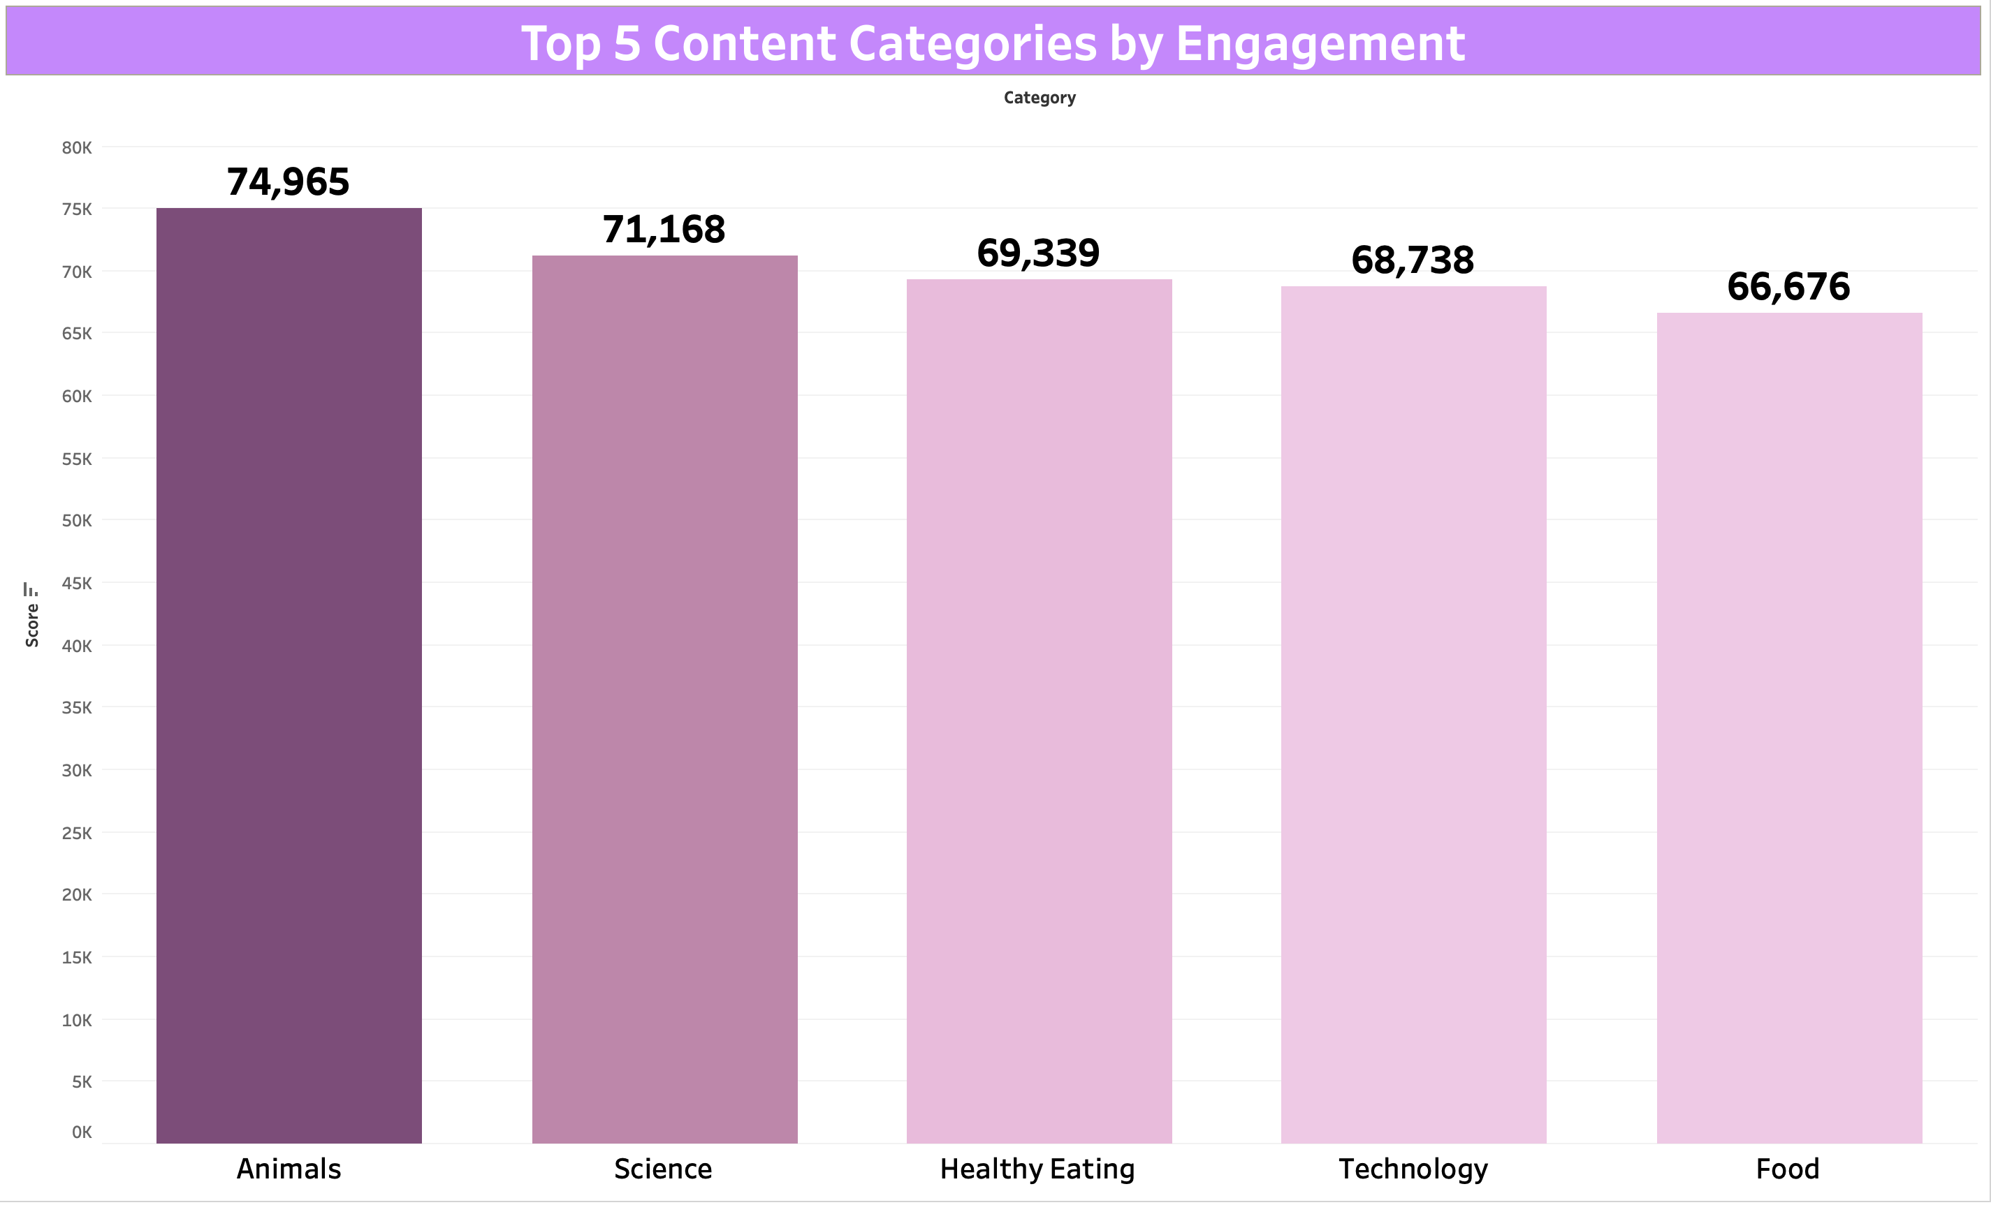

Slide 9
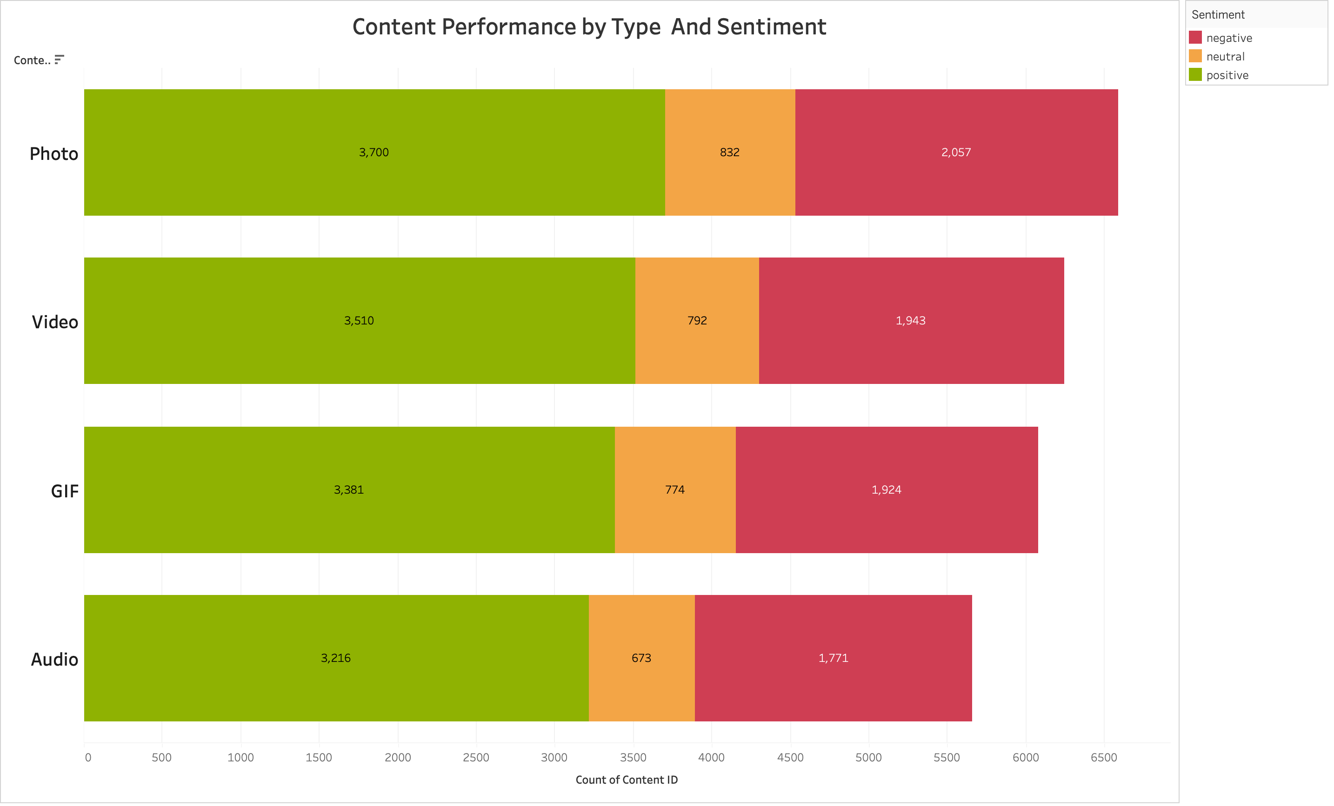

Slide 10
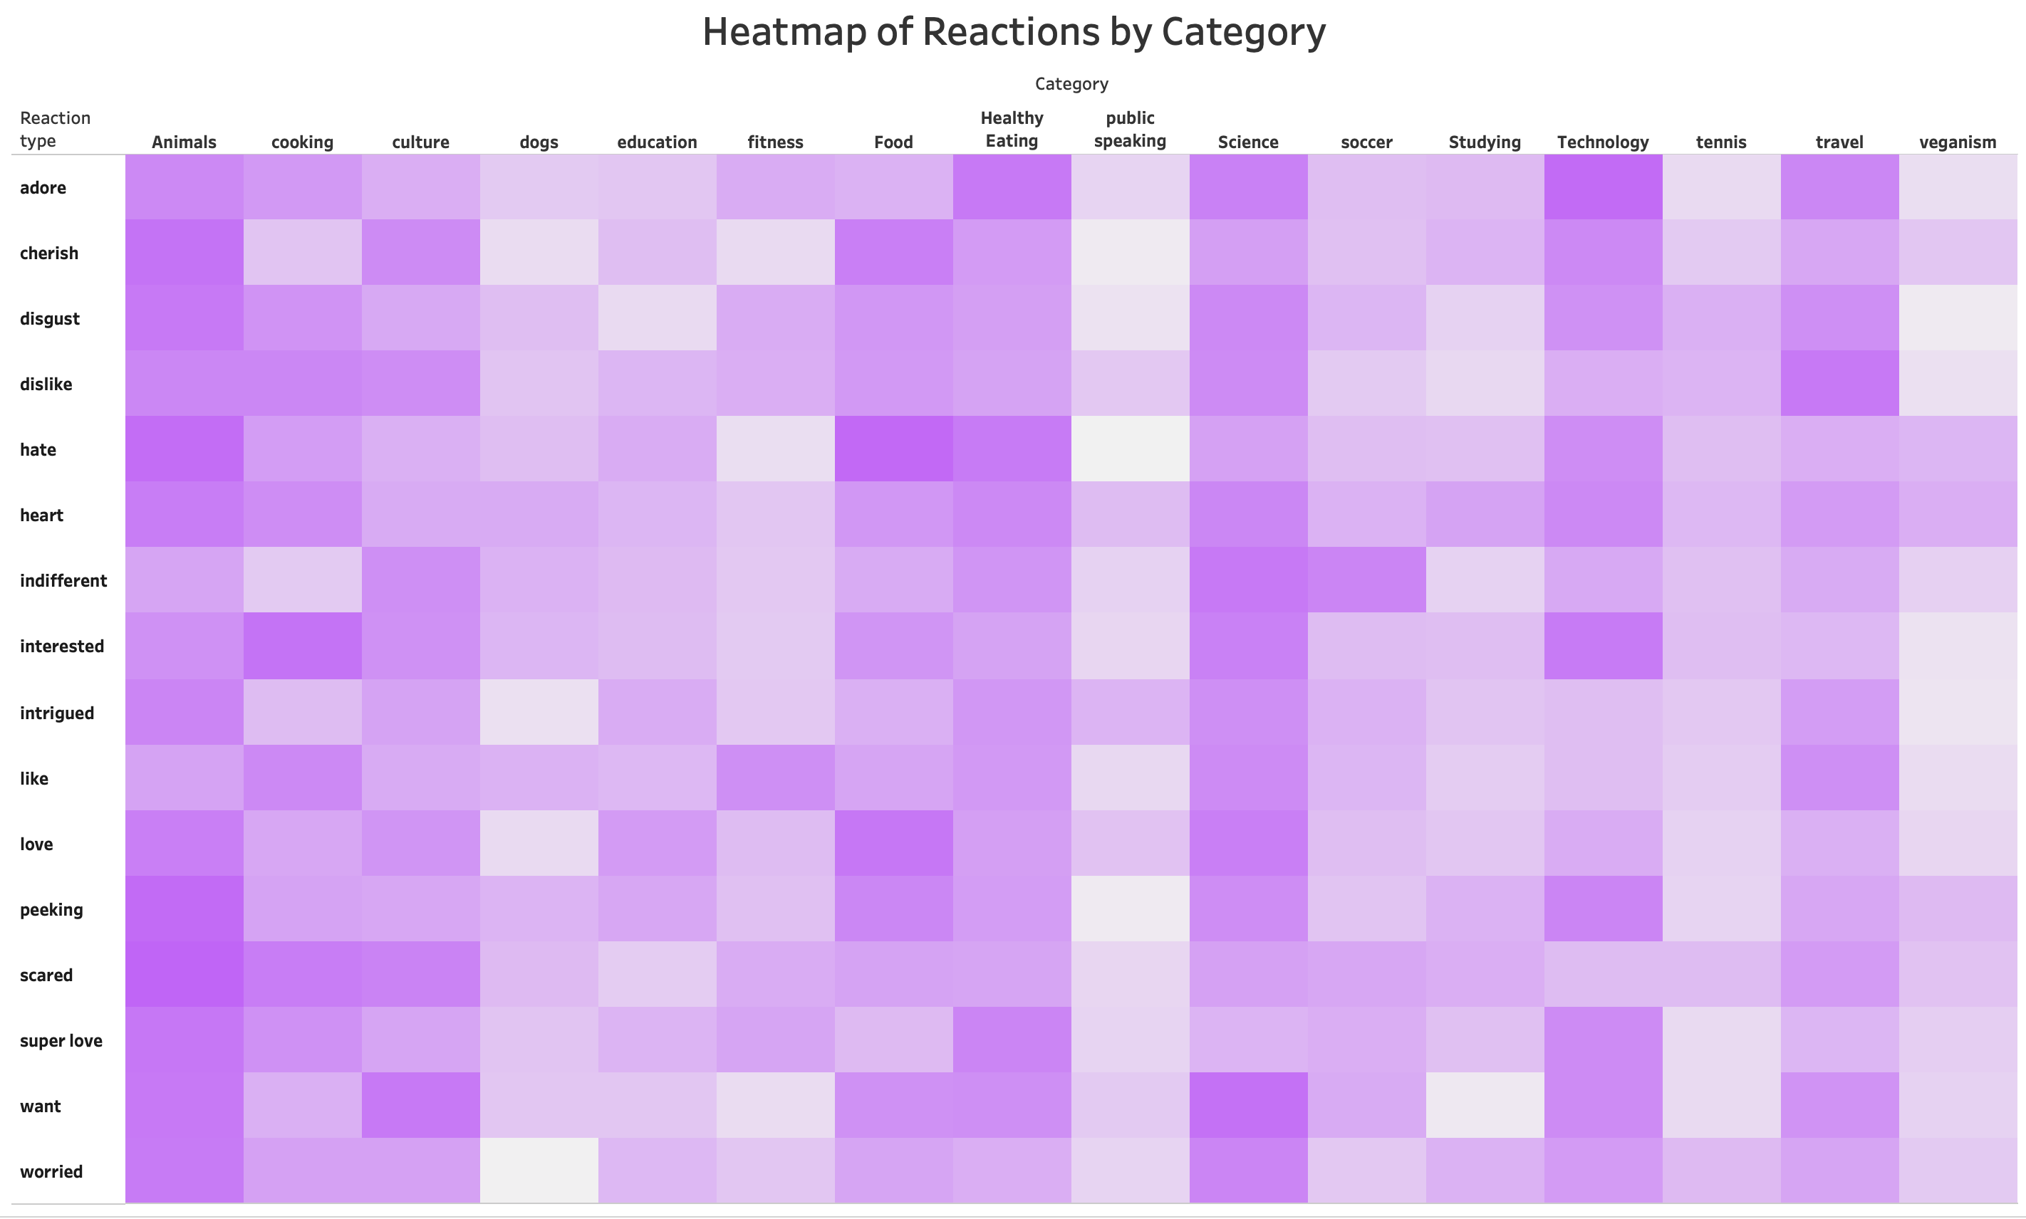

Slide 11

Top 5 Content Categories by Engagement: Identified top categories driving the highest user engagement, guiding content focus for maximum impact.
Content Performance by Type: Evaluated content types (photos, videos, etc) by sentiment, revealing which formats attract the most positive responses.
Heatmap of Reactions by Category: Mapped reaction intensity across categories, pinpointing content that elicits strong user responses for targeted strategy adjustments.
Summary

Slide 12

Thank you!
ANY QUESTIONS?

